Slide 1



DERM AI
DERM - AI
WWW.DERMAI.COM

Slide 2

CONTENT
DERM AI
01
ABOUT US
02
GOALS AND OBJECTIVES
03
ADVANTAGES
04
OUR SERVICES
05
IDEA AND APPROCH
06
HOW IT WORKS
07
NEXT UPDATE

Slide 3



ABOUT US
DERM AI
Our DERM-AI is a AI based skin disease predection which helps in finding all 23 types of disease and provides First Aid and Remedies

Slide 4





GOALS AND OBJECTIVES
Objective n° 2
Objective n° 1
Our main objective is to collect all dataset regarding to all types of disease and classify them and label them for prediction.
The final Goal and objective is to develop an application for prediction of diseases and deploy it in the market with high accuracy rate and medical council approval
DERM AI

Slide 5

ADVANTAGES
90%
DERM AI
USER FRIENDLY
FREE OF COST
FIRST AID
IMMEDIATE REMEDIES
ORDERING MEDICINES

Slide 6

OUR SERVICES
01
02
03
04
DERM AI
SUGGESTION FOR DIFFERENT TYPES OF TREATMENT
INCLUDED A ALL LANGUAGE BOT FOR INTERACTION
DIRECT CONTACT WITH DOCTOR FOR CLARIFICATION AND FUTHER SCOPE
DOOR STEP DELIVERY FOR MEDICIEN AND DOCTOR VISIT FOR PHYSICAL DISABLITIES AND URGENT CASES

Slide 7
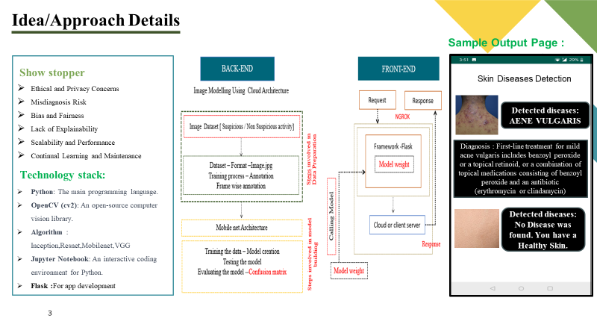
DERM AI

Slide 8
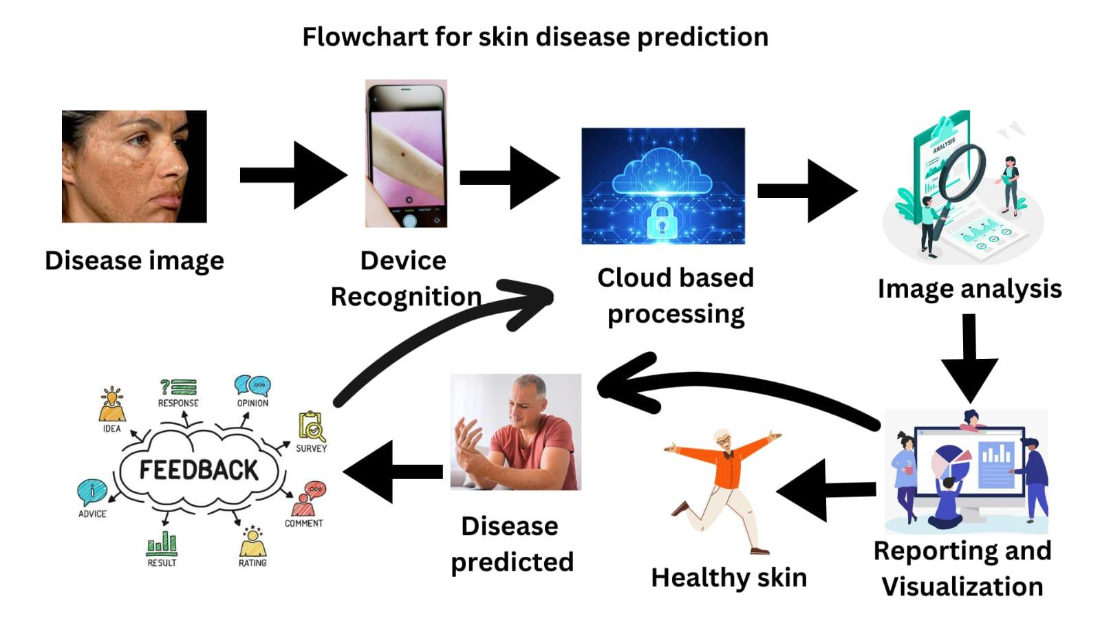
DERM AI

Slide 9

NEXT UPDATE
WE WILL EXPAND NOT ONLY NATION WISE BUT ALSO INTERNATIONAL WISE WITH THE SUPPORT WHO
PLAN TO UPDATE THE CURREN VERSION WITH USER EXPERIENCE AND FEEDBACKS
PLAN TO UPDATE WITH VARIOUS DISEASE NOT ON SPECIFIC DEPEARTMENT
PROJECT 3
PROJECT 1
PROJECT 2
DERM AI

Slide 10

THANK'S FOR WATCHING
DERM AI

